Slide 1
Defined Benefit Pension Plan Funding
By John Abraham,
Director, Center for Workers’ Benefits and Capital Strategies, AFT
November 15, 2017

Slide 2
Key 2016 Facts: UN Pension Plan
23 member organizations participate
128,262 participants (126,892 in 2015)
74,778 beneficiaries (71,474 in 2015)
$54.74B total assets ($52.45 B in 2015)
$2.59B total liabilities
$54.49B net assets available for benefits
Source: UN Joint Staff Pension Fund, “Financial Report and Audited Financial Statements for the year ended 12/31/16 and Report of the Board of Auditors” p.12

Slide 3
Normal Retirement Benefit
Normal Retirement Age
Age 65 for an employee hired after Jan 1, 2014
Age 62 for an employee hired after Jan 1, 1990 and before Jan 1, 2014
Age 60 for employees hired before January 1, 1990
Benefit is payable when separation is the normal retirement age and whose contributory service is 5 years or more
The benefit:
The 1st 5 years of service, by 1.5% of the final average remuneration (FAR)
The 2nd 5 years of service, by 1.75% of the FAR
Next 25 years of service, by 2% of the FAR
Years in excess of 35 and performed after 1 July 1995, by 1 percent of the FAR, up to a maximum total accumulation rate of 70% of FAR
Note: The benefit for service prior to Jan 1, 1983 is 2% x FAR for the 1st 30 years, then 1% for the next 5 years maximum.
Source: Regulations, Rules and Pension Adjustment System of the United Nations Joint Staff Pension Fund (1/1/2015), p. 12

Slide 4
Example of a UN Retiree
A UN worker is retiring in 2016 after 25 years of service, with a final average salary of $167,784.87*
Final Average Salary: | $ 167,784.87
First 5 Years (final average salary x (0.015x5)) | $ 12,583.87
Next 5 Years (final average salary x (.0175x5)) | $ 14,681.18
Remaining 15 Years (final average salary x (.02x15)) | $ 50,335.46
Total (sum of first, next and remaining years) | $ 77,600.50
Income Replacement Rate | 46% (Final Average Salary/Total Pension)
*highest three years salary out of the last five years of service

Slide 5
Basic Funding Equation
C + I = B + E, Where
C = contributions $2.27 B, ‘16
I = investment earnings 2.67 B, ‘16
B = benefits
E = plan expenses
Difference
2.59 B, ’16
2.35 B, ‘16
Source: UN Joint Staff Pension Fund, “Financial Report and Audited Financial Statements for the year ended 12/31/16 and Report of the Board of Auditors” p.14

Slide 6
Actuarial Costing (How to fund the promised benefit)
The basis of funding a pension plan is the concept of actuarial present value
It’s a way of determining how much money to put aside during working years to pay for a benefit in the future.
Two of the variables for these calculations are:
Probability that a worker will attain retirement age, (which considers turnover, disability and death) and
Assumed rate of growth of investment earnings over time

Slide 7
Actuarial Costing, cont.
A plan’s total expected cost consists of a series of contingent future events under which benefits will be paid in specified amounts
Simple illustration of how actuarial costing works:
A benefit of $13,500 might be paid to a participant, currently age 25, if he or she continues to work for the employer until age 65.
A separate benefit of $6,000 is payable to any participant who terminates employment at 40 and applies for a benefit at age 65

Slide 8
Actuarial Costing, cont. (A simple illustration)
Assume there are 100 newly hired participants in a plan and each is 25 years old.
The plan’s benefits: $6,000 (at age 65) for leaving at age 40 and $13,500 for leaving at age 65
Actuary estimates that 10 employees will leave at age 40, and remaining 90 will stay to age 65
Actuary also estimates that of 10 job leavers, 8 will survive to age 65; of the remaining 90 employees, 85 will survive to age 65

Slide 9
Actuarial Costing, cont.
Based on these factors, the total benefits the plan is expected to pay can be determined as follows:
8 participants will work to age 40 and survive to age 65 & receive a benefit of 8 X $6,000 = $48,000, due in 40 years.
85 participants work to age 65 and collect a benefit of 85 X $13,500 = $1,147,500, due in 40 years

Slide 10
Actuarial Cost Timeline
Q: How much is to be paid into the fund each year to attain $1,195,500 in 40 years?
Actuary estimates how to fund a total benefit of $1,195,500, due in 40 years
Age 25
100 employees
Age 40
10 leave
Age 65; 85 live to 65 and each get $13,500 =
$1,147,500
8 live to 65 and each get $6,000 = $48,000

Slide 11
Actuarial Costing cont.
If we assume a 6% rate of return on contributions, and consult a financial table, titled “Future Value of an Ordinary Annuity,” we find 154.7620 at the intersection of 6% and 40 years. Dividing $1,195,500 by 154.7620 equals a contribution of $7,725 per year
Alternatively, a financial calculator inputs of: FV $1,195,500, N 40, I 6% = PMT of $7,725 per year

Slide 12
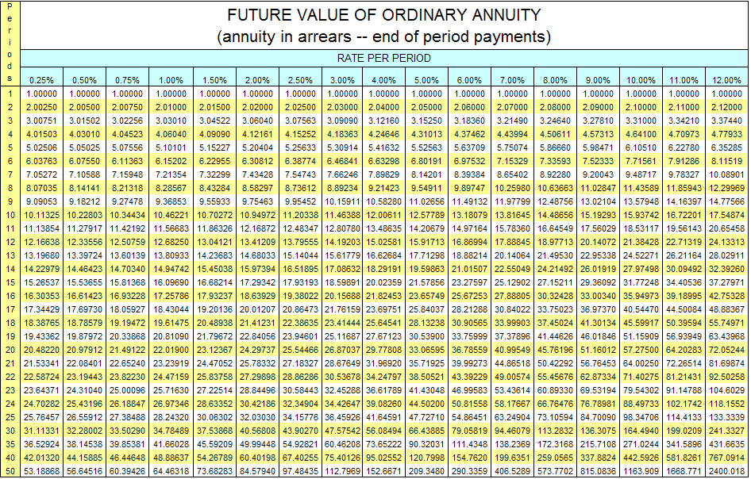

Slide 13
Other Actuarial Assumptions
Age of retirement
Rate of return on investments ( ROR Cont.)
Turnover rates
Mortality rates
Annual inflation rate
Annual wage increases
Disability rates
Percent of retirees electing J&S option
Life expectancy after retirement (DB benefit)

Slide 14
Actuarial Cost Methods
Our example shows that if we set aside $7,725/year and earn 6% each year for 40 years we will have a balance of $1,195,500 when our workforce turns 65—exactly what is needed!
However, there are other ways to prefund a pension over 40 years—besides level $ cont.
Step down funding
Step up funding
Level percent of pay funding
Lump sum funding

Slide 15
Actuarial funding Methods cont.
Step down Funding
Step Up funding
Dollars or % of pay
Level $ or % of pay funding
0 YEARS
Lump sum funding $116,229 at start
40 years
TIME/YEARS

Slide 16
Accounting for Actuarial Gains/Losses
Invariably economic and demographic assumptions will prove to be inaccurate
What if the plan earned 9% ROR instead of the assumed 6% in the example?
The unexpected increase produces and actuarial gain
What if at age 40 only 5 employees leave instead of 10?
This change produces an actuarial loss, as more people will get a benefit at age 65 than expected

Slide 17
Actuarial Cost Methods cont.
The goal of the prefunding actuarial cost methods is to produce a reasonable cost pattern over an employee’s working career.
However, gains or losses can create volatility in the cost pattern.
Investment returns represent one of the main sources of actuarial gains and losses .
In order to reduce volatility, most sponsors use actuarial smoothing techniques to value plan assets (as opposed to recognizing gains/losses on an annual basis) – this is called actuarial valuation

Slide 18
